Slide 1
Absolute camera localization Leonhard Feiner, Alexander Ziller

Slide 2
Introduction
Goal:
Test if multitask learning with semantic segmentation improves camera localization accuracy
Input:
Test time: Camera images (stereo)
Train time: Semantic labels, Poses, (Depth Images)
Output:
Camera position and orientation (3x translation, 3x log quaternion)
Motivation:
Multiple robotics applications
Autonomous driving

Slide 3
Related Work
State of the Art: MapNet (2018)
Pose Regression for camera localization
Uses images and other sensory inputs (e.g. GPS, VO).
Continues learning in unsupervised manner after training.
Brahmbhatt, Samarth, et al. "Mapnet: Geometry-aware learning of maps for camera localization." arXiv preprint arXiv:1712.03342 (2017).

Slide 4
Related Work
State of the Art: VLocNet++(2018)
Pose Regression for Camera Localization
Has a semantic segmentation network included.
Output of segmentation is input to Pose Regression Network
Radwan, Noha, Abhinav Valada, and Wolfram Burgard. "Vlocnet++: Deep multitask learning for semantic visual localization and odometry." arXiv preprint arXiv:1804.08366 (2018).

Slide 5
Related Work
State of the Art: Multi-Task Learning Using Uncertainty to weigh losses for Scene Geometry and Semantics (2018)
Proposes a way to perform multi-task learning.
Based on weighing loss functions.
This was shown to improve performance for depth regression.
Kendall, Alex, Yarin Gal, and Roberto Cipolla. "Multi-task learning using uncertainty to weigh losses for scene geometry and semantics." arXiv preprint arXiv:1705.07115 3 (2017).

Slide 6
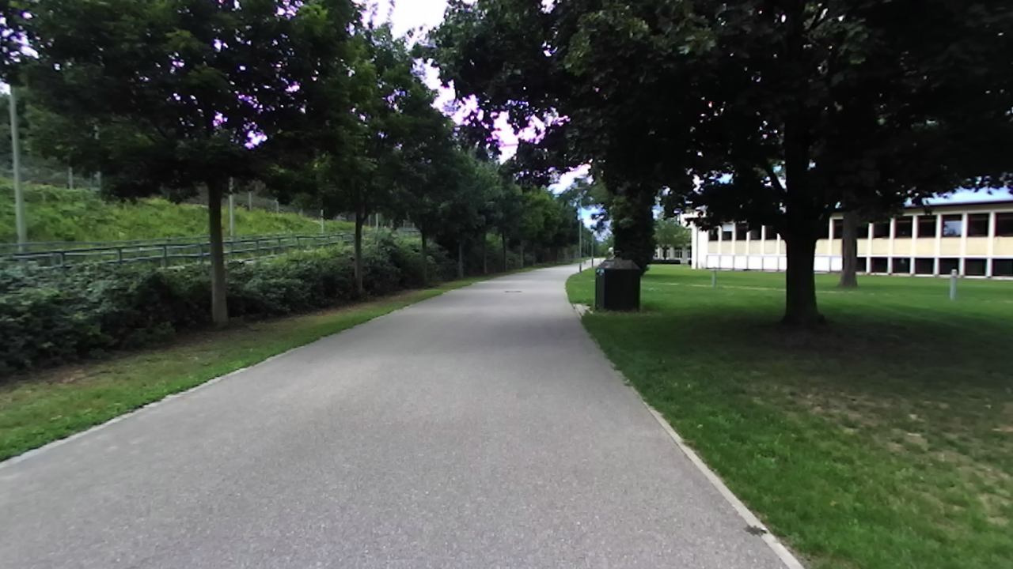
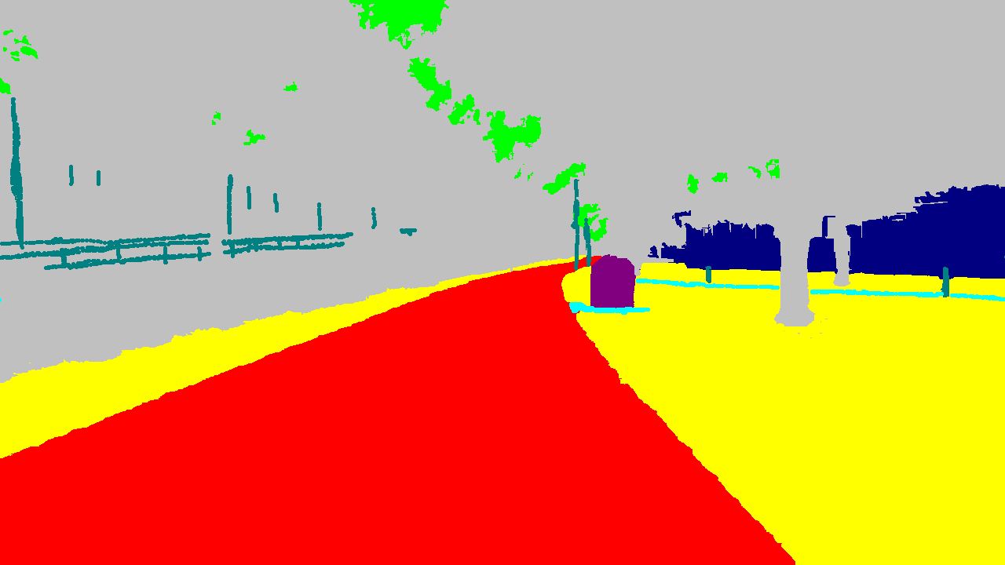
Datasets
Dataset we use is DeepLoc
Consists of:
Stereo Images
Depth Image
Semantic labels (every second image)
Poses (groundtruth)
58 GB overall
2737 training points
1173 validation points

Slide 7
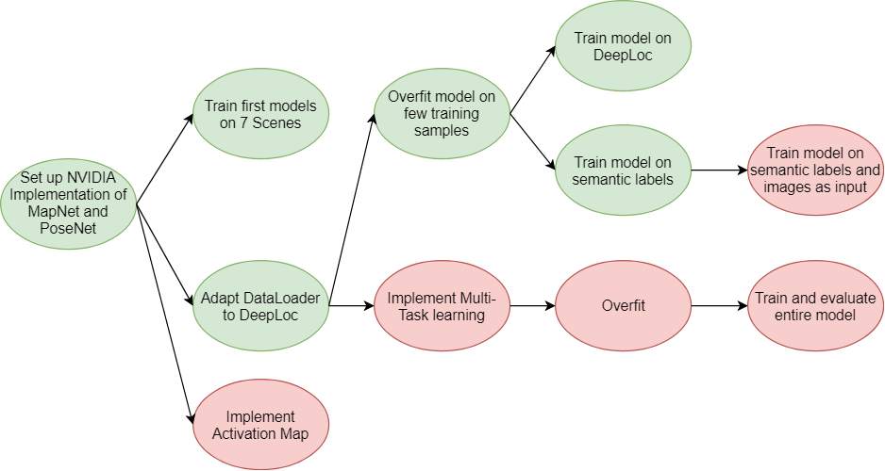
Project plan

Slide 8
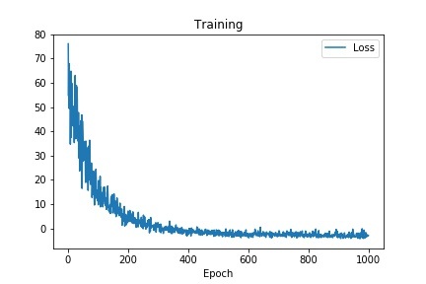
Preliminary results
Overfitting on two images
Error |  | mean
Train | translation | 0.02 m
 | rotation | 2.96°

Slide 9
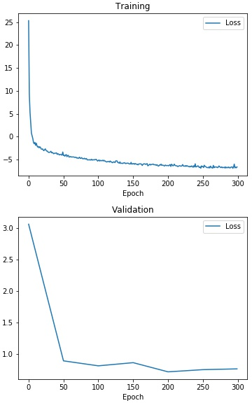
Preliminary results
Training standard MapNet on DeepLoc
(as baseline)
Error |  | median | mean
Train | translation | 1.28 m | 1.51 m
 | rotation | 2.92° | 3.65°
Validation | translation | 2.28 m | 2.90 m
 | rotation | 5.80° | 14.05°

Slide 10
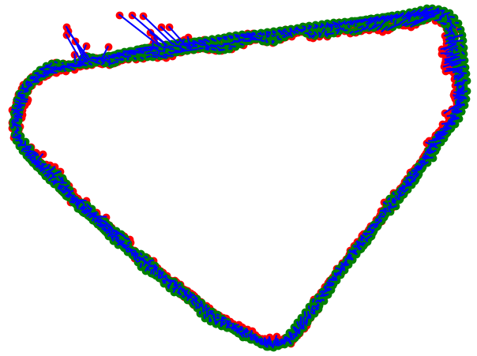
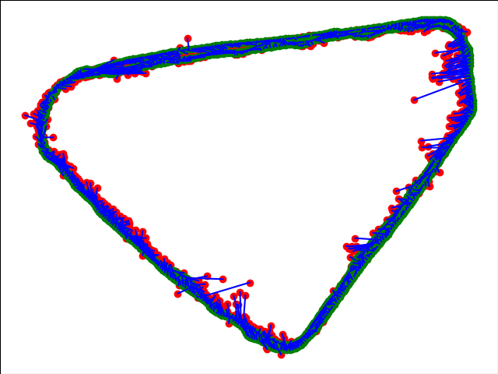
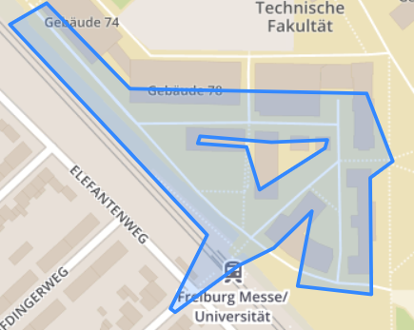
Preliminary results
Training Validation

Slide 11
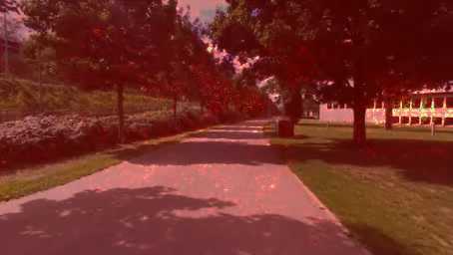
Notes:
Attentions

Slide 12
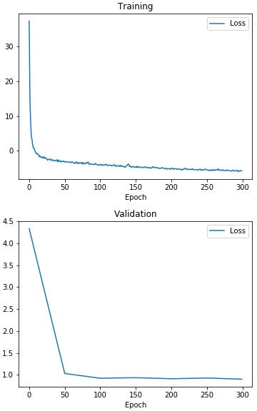
Preliminary results
Training mapnet on
colorized semantic labels
Error |  | median | mean
Train | translation | 2.95 m | 3.10 m
 | rotation | 4.91° | 5.10°
Validation | translation | 3.40 m | 3.91 m
 | rotation | 7.51° | 19.87°

Slide 13
Preliminary results
Problems we encountered
Different format of DeepLoc
Only each second frame has semantic labels
Frame number 2689 is missing
Notes:
Frame number 2689 is missing = > multiple errors until we’ve found the problem

Slide 14
Next steps
Draft of multi input architecture
concatenation
reuse of MapNet
input
image
feature extractor
pose decoder
loss
input
semantics
feature extractor
Notes:
Require semantic labeles for inference

Slide 15
Next steps
Draft of multi-task architecture
reuse of MapNet
semantics decoder
loss
encoder
(partly pretrained
e.g. ResNet)
input
image
pose decoder
loss
Notes:
Require semantic labeles for inference

Slide 16
Conclusions
MapNet is capable of learning on DeepLoc dataset
It can be also trained on semantic labels instead of images
We want to train Multi-task network
Goal: improve pose regression

Slide 17
Thank you

Slide 18
Preliminary results
Training standard MapNet on DeepLoc (as baseline)
Train
Error in translation: median 1.23 m, mean 1.33 m
Error in rotation: median 2.38 degrees, mean 2.98 degree
Validation
Error in translation: median 1.73 m, mean 2.11 m
Error in rotation: median 4.63 degrees, mean 12.67 degree

Slide 19
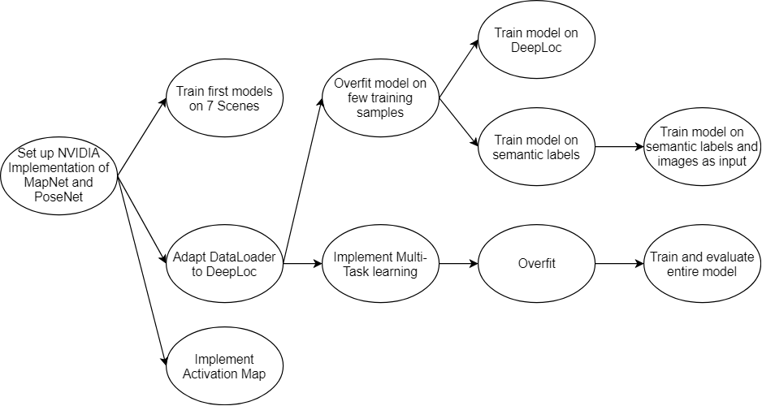
Project plan

Slide 20
Next steps
Train on semantic labels and camera images at the same time
Implement multi-task learning with two heads (pose regression, semantic segmentation)
Implement visualization of activation maps

